Slide 1
Presentation Guidance – DO NOT PRESENT
Title | Power BI Desktop Overview
Purpose | Introduce core capabilities of Power BI Desktop for report authoring
Audience | Customers – Business Analyst and Director of BI/Finance/Analytics
Content Level | Level 200
Deck Owner | Miguel Martinez (alias: miguem)
Usage Guidance | Use this deck, along with the Power BI Desktop demos at aka.ms/bi This deck is meant to be a double click for business analyst that lead teams that work on analytics. Ideally, it is delivered after the Power BI overview deck but can be presented in isolation depending on the audience. Each section of the data analytics journey has a summary of the most important features. The appendix has a demo recommendation and double clicks on some features such as DAX modeling, accessible advanced analytics and built-in intelligence if customer wants to learn more about a specific subject. Other useful assets to have for this conversation are the departmental customer decks and demos (Finance, Marketing, Operations, HR and IT), and our Tableau compete content. All assets can be found at aka.ms/bi.
Version | Last updated: January 2018
Presentation Guidance

Slide 2


Power BI Desktop overview
Senaj Lelic
Trainer
WW Education

Slide 3
Transforming with data: your opportunity
Extra productivity benefits by 2020
Additional operating income
$430B
8%
Gained by organizations able to analyze all relevant data and deliver actionable information
Source: IDC “FutureScape: Worldwide Big Data and Analytics 2016 Predictions,” DOC #259835, November 2015
Generated by the most digitally transformed enterprises
Source: Keystone Strategy 2016

Slide 4


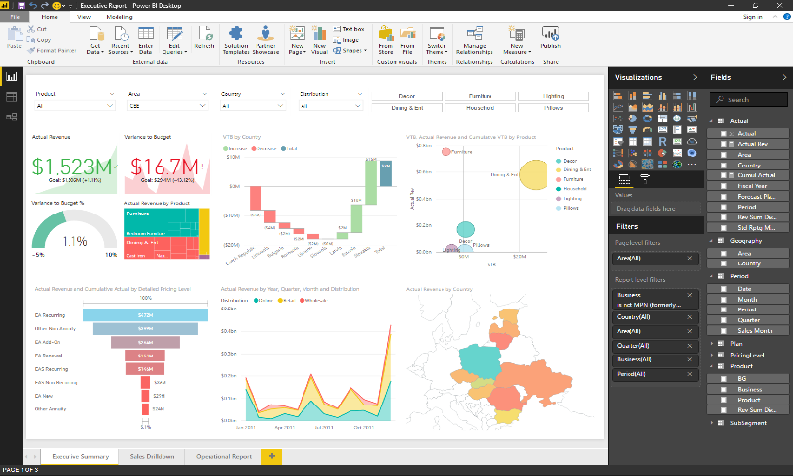





Transforming with data: the Business Analyst role
Get Data
Analyze
Visualize
Visualize
Power BI Desktop is a free companion authoring tool for the Power BI service, updated monthly with new features
Publish
Collaborate

Slide 5





















Get Data: Easily connect, clean, and mashup data
Connect to 80+ data sources, both on-premises and cloud
Shape, transform, and clean data for analysis
Live connectivity to on-premises and cloud data sources
Extend with custom data connectors for any data source

Slide 6
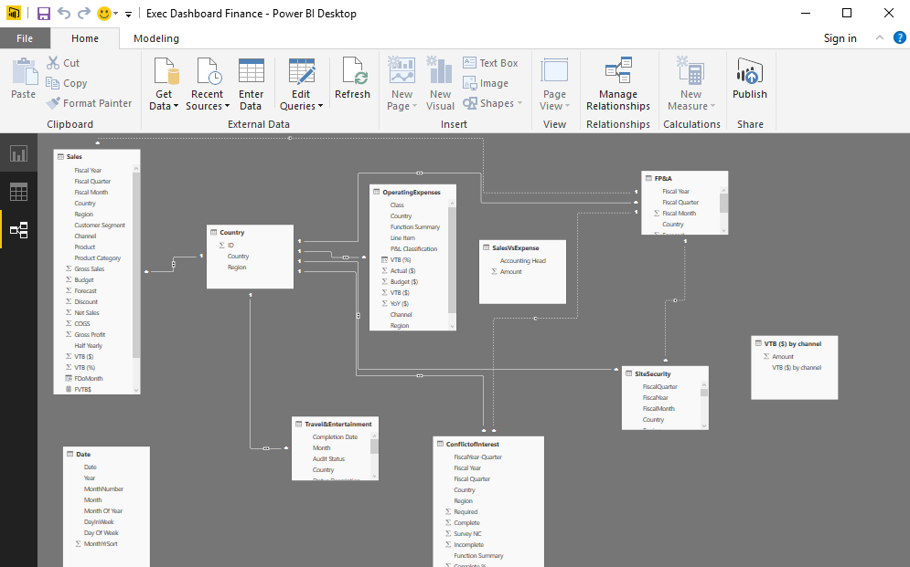
Analyze: Build powerful models and flexible measures
Automatically created model when connecting to data
High-performance, in-memory engine
Point and click analysis with Quick Measures, Clustering and Binning
Create powerful measures with familiar DAX formulas

Slide 7

Visualize: Create stunning interactive reports
Author reports using 150+ visuals via a drag-and-drop canvas
Explore data across multiple interactive visualizations
Provide insights in the context of your business with Custom Visuals
Visualize your data story with bookmarks and custom navigation

Slide 8
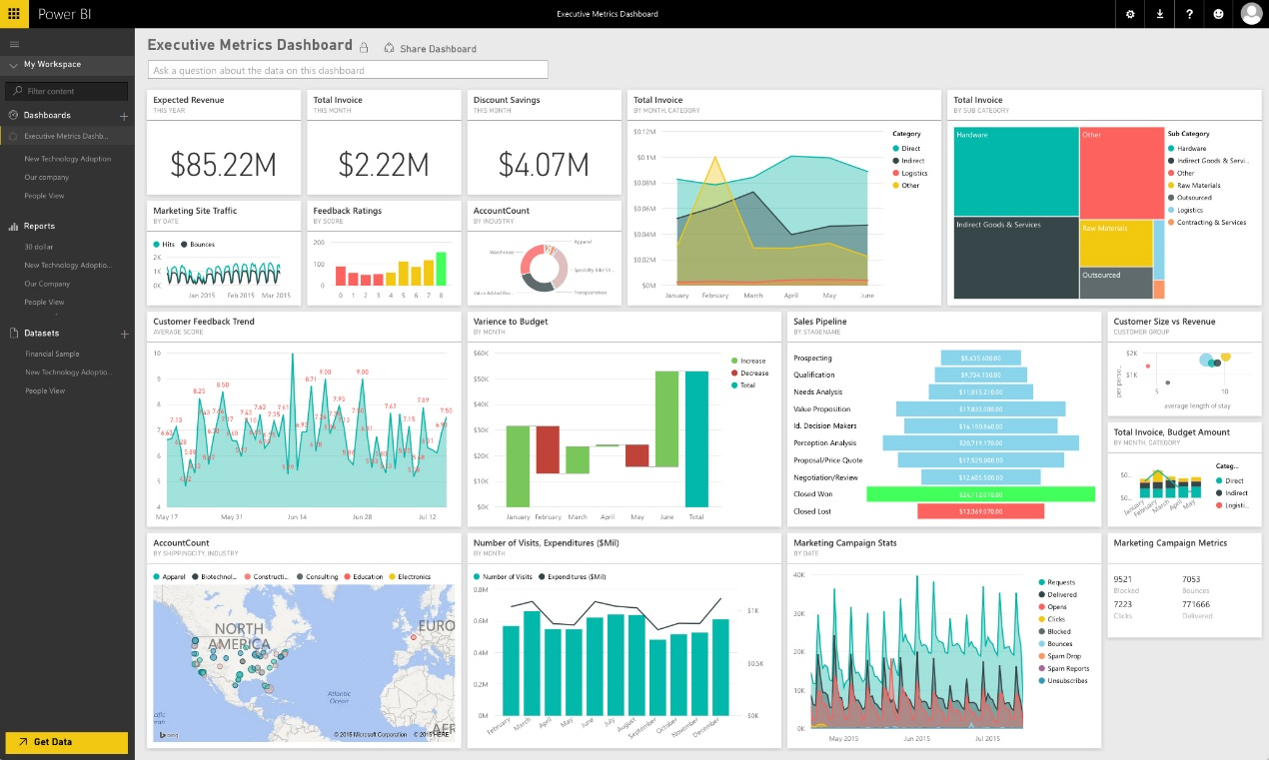
Publish: Share insights with others
Publish directly to the cloud or on-premises
Automatic data refresh, so your reports are always up to date
Package your reports in apps for easy consumption and control
Manage your analytics content with admin and governance tools

Slide 9
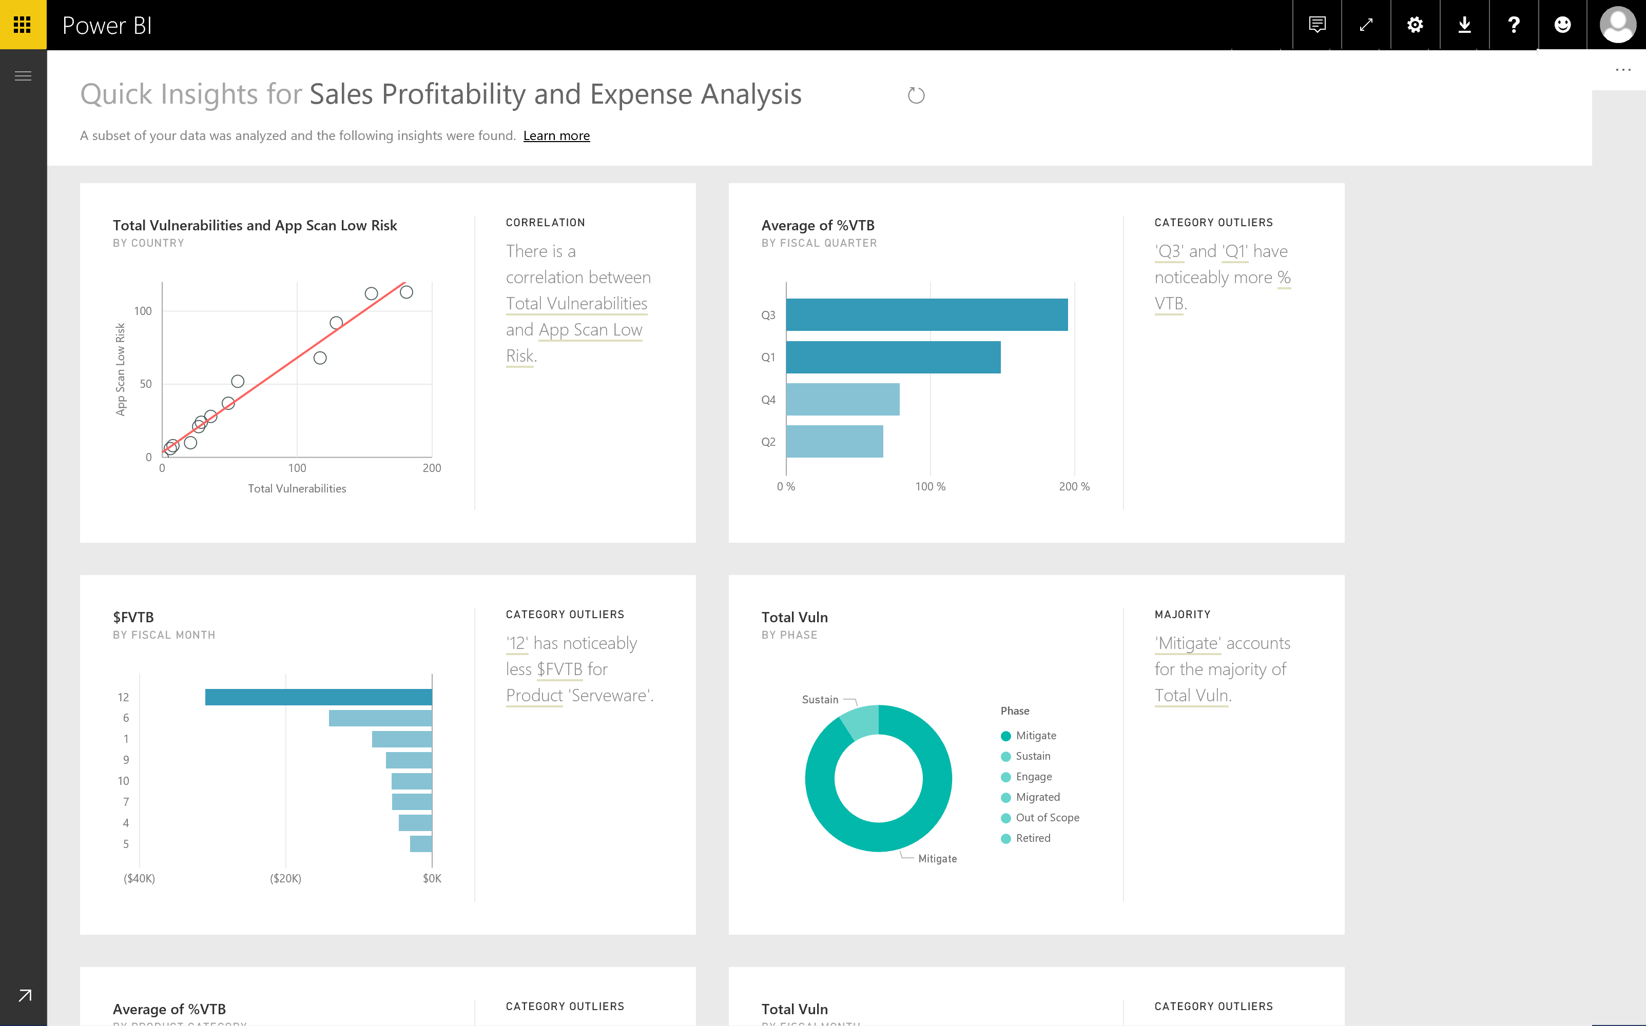
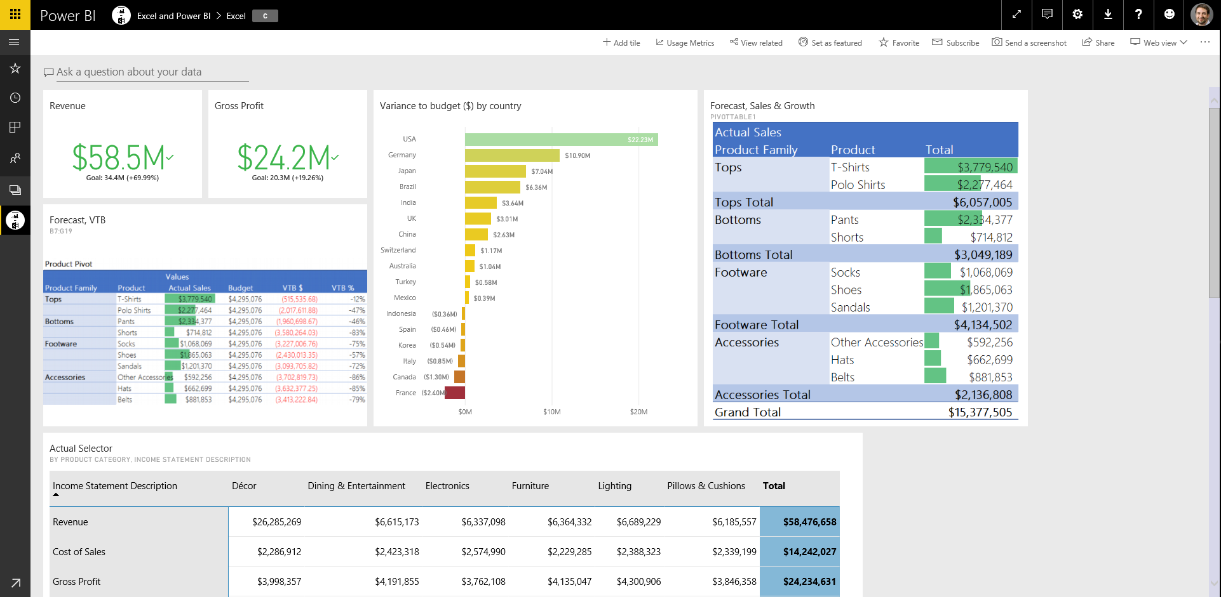
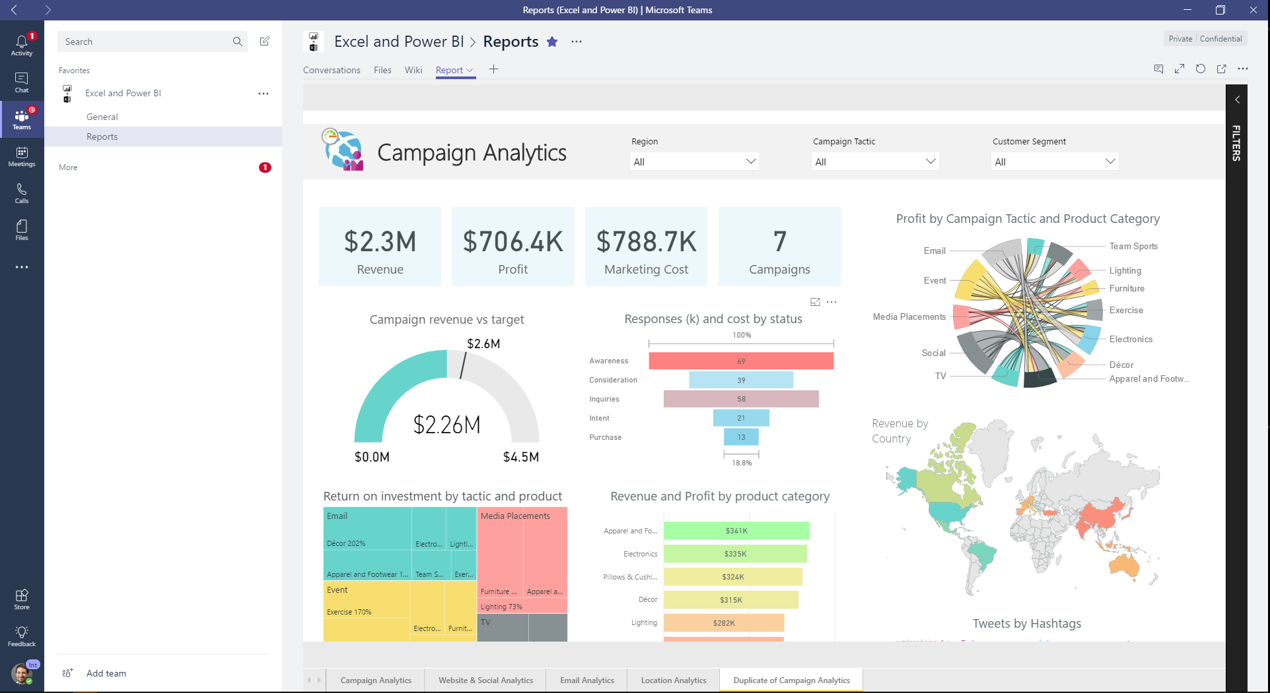
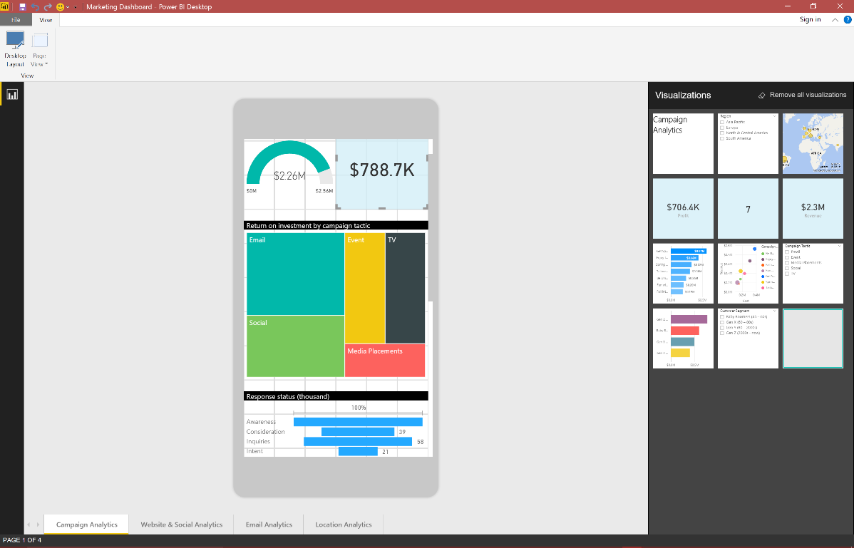





Collaborate: Empower your organization
Provide access to reports and dashboards anywhere on any device
Enable users to Ask questions and automatically discover insights from the data
Deliver insights through other services such as Sharepoint and Teams
Connect live to your models in Excel and Power BI Desktop

Slide 10
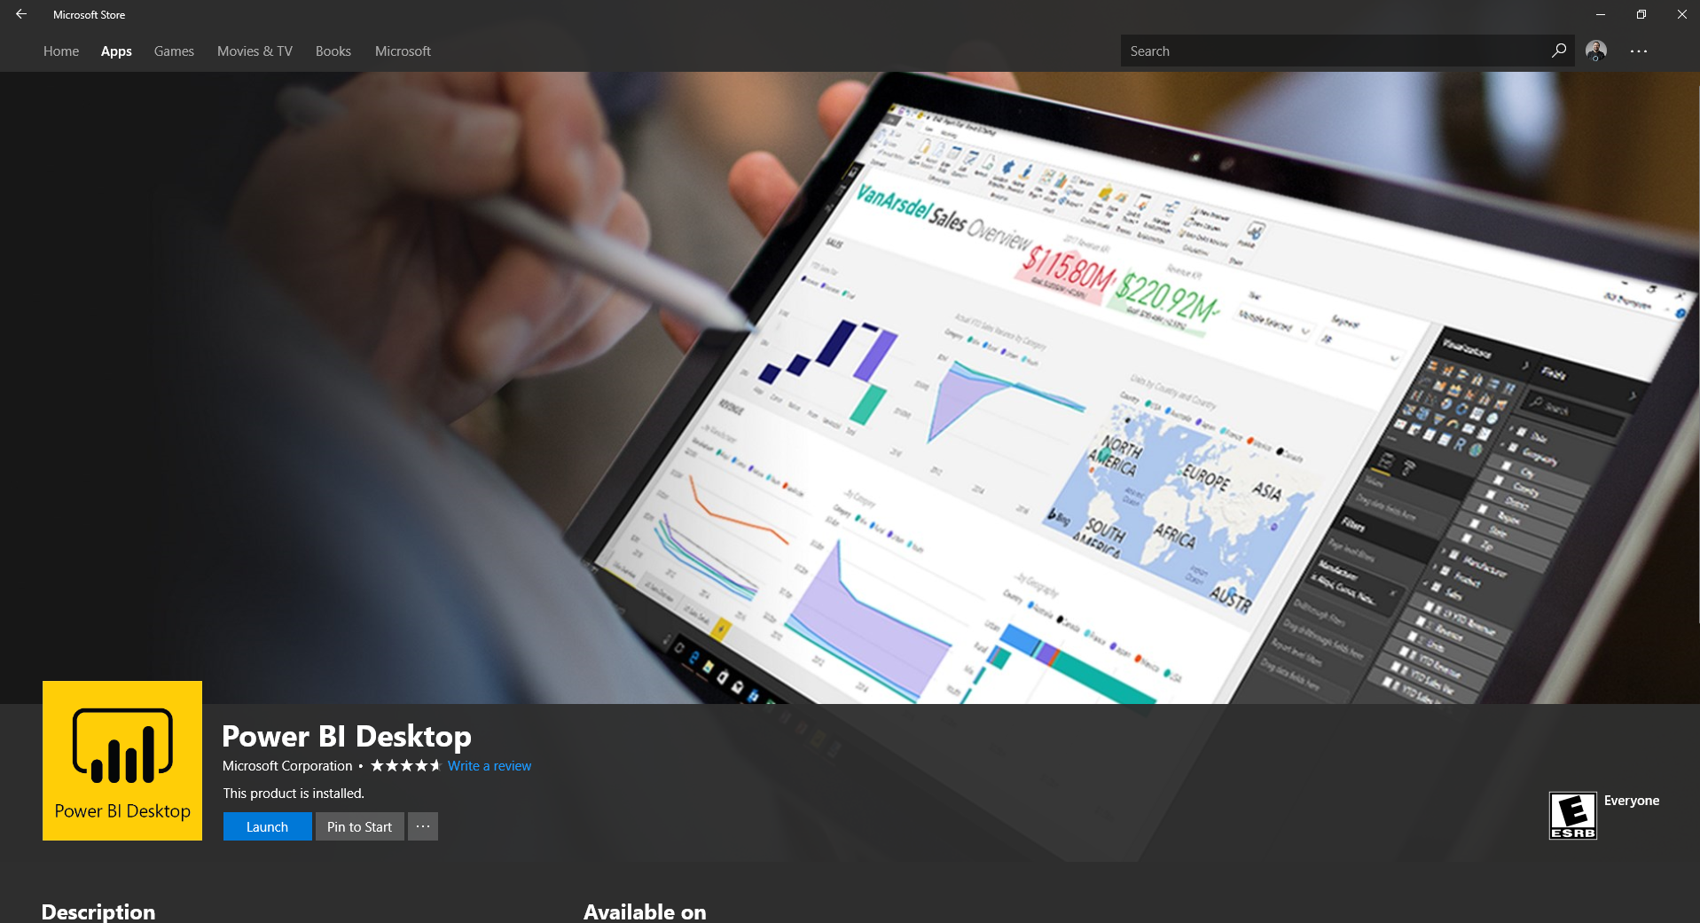
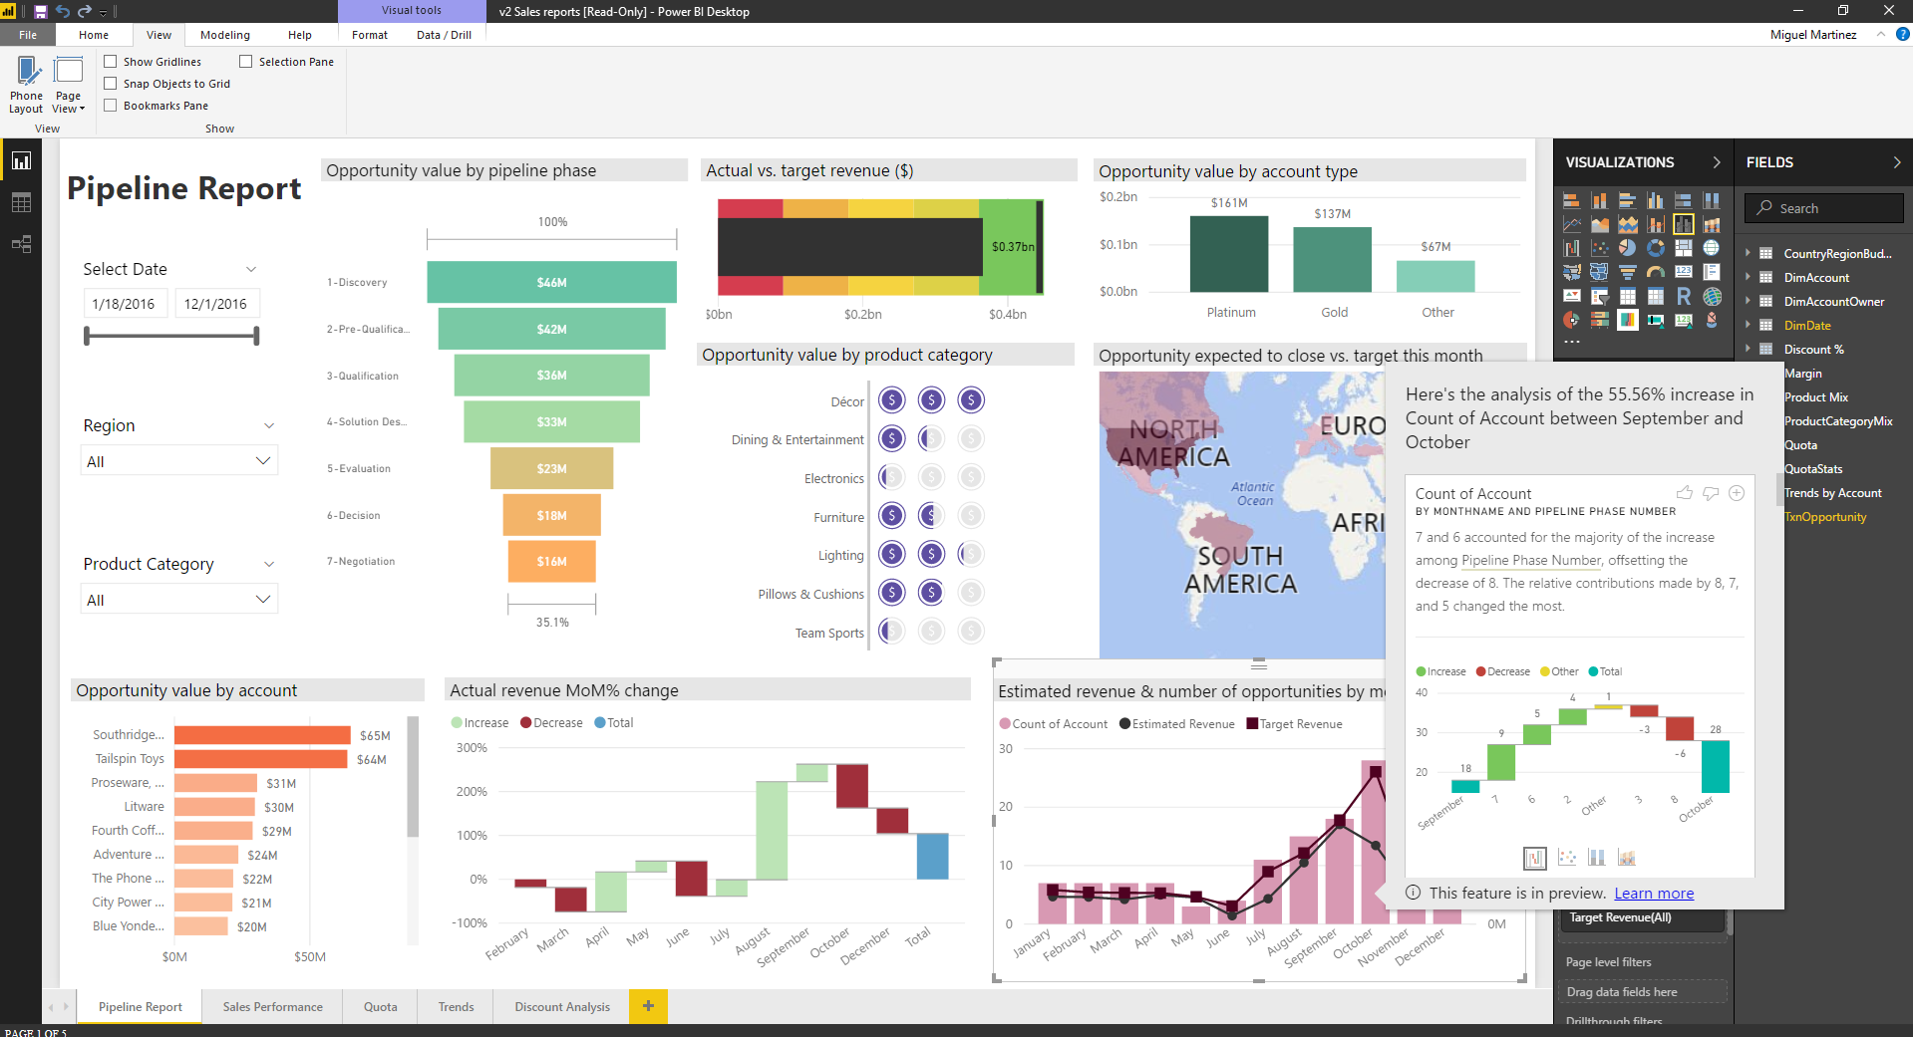
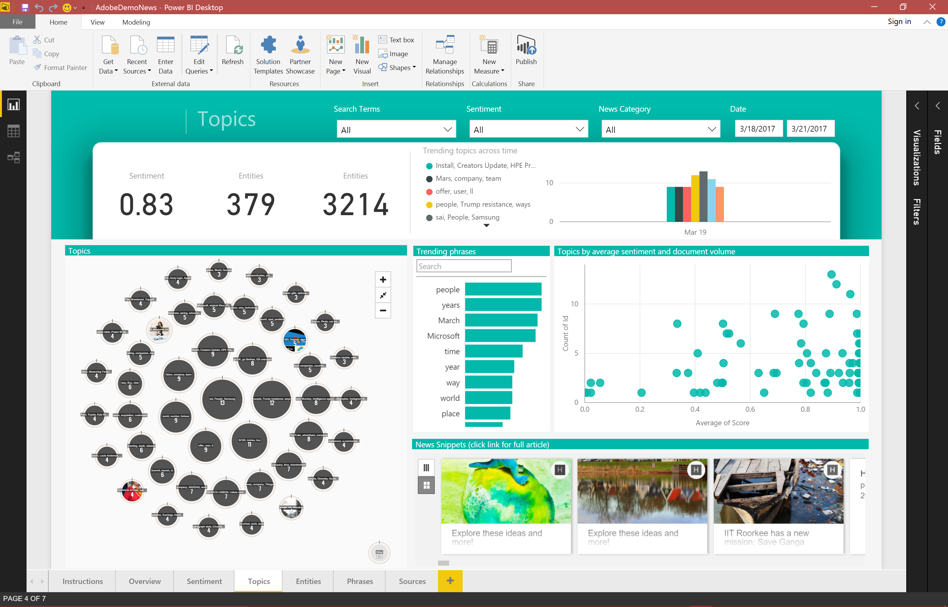
It is easy to Get Started Download for free at PowerBI.com or the Windows Store
Benefit from continuous updates and community-driven innovation
Streamlined for no-code advanced analytics
Built-in intelligence to speed up your analysis
Automatic updates from the Windows Store

Slide 11


Slide 12
Appendix

Slide 13
Demo Power BI Desktop
Use the Power BI Showcase demo to show Desktop capabilities and scenarios:
Connect to Excel data source
Data preparation and mash-up
Creating a model and measures
Create a report with visuals
Advanced analytics

Slide 14
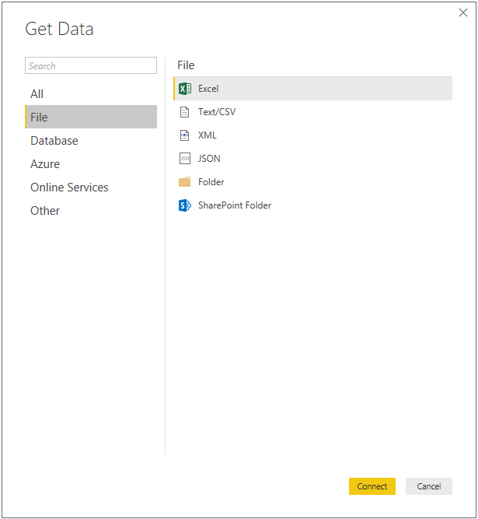
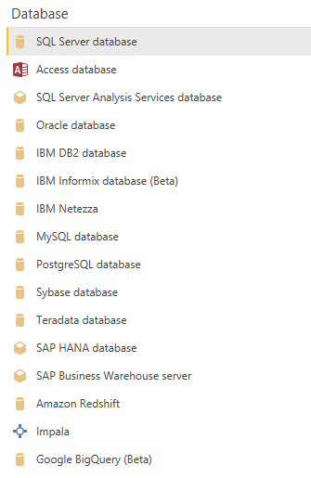
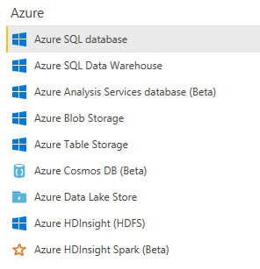
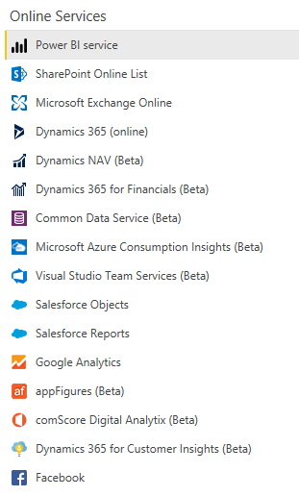
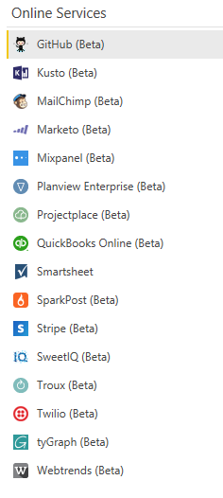
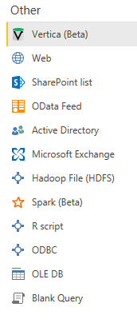
Power BI Desktop Data sources Over 80+ data sources and growing

Slide 15
Shape data into the format and structure you need
Common data-shaping tasks
Remove rows
Rename/Remove tables and columns
Change a data type
Delete Relationships
Pivot columns and group rows
Modify a table name
Identify and fix errors
Merge or append queries to combine data from multiple queries into a single query
Extract week day, month name, hour from date/time values
Transform data to fit your needs using intuitive UI
Select data for inclusion
Cleanse data and remove errors
Precisely tune the query step sequence: re-order, add, edit or delete steps as needed
Modify data types to support specific calculation requirements
Very powerful for advanced scenarios such as Mashups
Run R scripts
Shape and combine data

Slide 16
Data Connectivity Modes in Power BI Desktop
 | Import | DirectQuery | Live/Exploration
Overview | ETL Data download | Select specific tables No data download Queries triggered from Report visuals | Explore source objects from Report surface No data download Queries triggered from Report visuals
Supported Data Sources | All sources (>80 sources) | SQL Server Azure SQL Database Azure SQL Data Warehouse SAP HANA Oracle Teradata | SQL Server Analysis Services (Tabular & Multidimensional)
Max # of data sources per report | Unlimited | One | One
Data Transformations | All transformations (100’s) | Partial support (varies by data source) | None
Mashup Capabilities | Merge (Joins) Append (Union) Parameterized queries | Merge (Joins) Append (Union) | None
Modeling Capabilities | Relationships Calculated Columns & Tables Measures Hierarchies | Calculated Columns Measures Change Column Types | None
With Power BI Desktop, you can connect to your data in three ways:
Import
DirectQuery
LiveConnect

Slide 17
User-driven innovation with continuous updates
Reporting
Bookmarking (preview)
Selection pane and visual display controls
Bookmark links for shapes and images (preview)
Spotlight
Scatter and bubble markers
Increase the number of data points shown in scatter charts
Drillthrough to another report page
Explain the increase/decrease insights (preview)
Ribbon chart
Theming preview update—chart style controls
Accessibility improvements: Accessible See data and keyboard shortcut helper dialog
High density scatter chart sampling
Cartesian gridline style control
Visio visual (preview) Show values on rows for matrix
Color scales on font colors for table and matrix
Custom subtotal settings per level of matrix
Line styles and legend options
Scatter chart performance improvements
New table and matrix visuals are now generally available
Renaming fields in visuals
Custom visuals store integration
Relative date filters
Responsive layout for visuals (preview)
New waterfall chart option—breakdown
Data bars for new table and matrix (preview)
Markers on line and area charts
Consume Power BI reports with keyboard navigation and screen reader support and create accessible reports
Visuals font family setting
Horizontal Image Slicer
Shade area of the line
Bing maps improvements
Map themes
Improved geo hierarchy experience
High density line sampling
Relative date slicer (preview)
New table visual (preview)
Combo chart data label enhancements
More URL support in table and matrix
Mailto links in textbox
Analytics
Quick measures for SSAS live connections
Sales from new customers quick measure
Cell-level formatting for multidimensional AS models
What if parameters
New scatter chart analytics features
Symmetry shading
Ratio line
New quick measure: weighted average
Quick measures from the community: Star rating and concatenated list of values
Bidirectional cross filtering for DirectQuery is now generally available
Report level measures for live connections to Analysis Services tabular models and Power BI service datasets
2 new quick measures (preview): Total for category and Rolling average
Bin by count
Data connectivity
Vertica connector (beta)
SAP BW connector: support for additional member properties
Azure Consumption Insights connector
Improvements to the Dynamics 365 for Financials connector
Live connect to the Power BI service is generally available
Google BigQuery connector (beta)
Snowflake connector general availability
Power BI service Live Connect to On-Premises and Push datasets
Impala connector GA
Amazon Redshift GA
SAP BW connector—DQ support (beta)
IBM Netezza connector (beta)
New connector: Dynamics 365 for Customer Insights
Combine files— ability to reference “First File” as example
Other
Two new transforms:
Extract text before/after/between delimiters
Unpivot only selected columns
“Add Column From Examples” enhancements
Power BI Desktop in the Windows Store
Improved access to help content

Slide 18
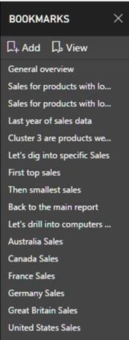
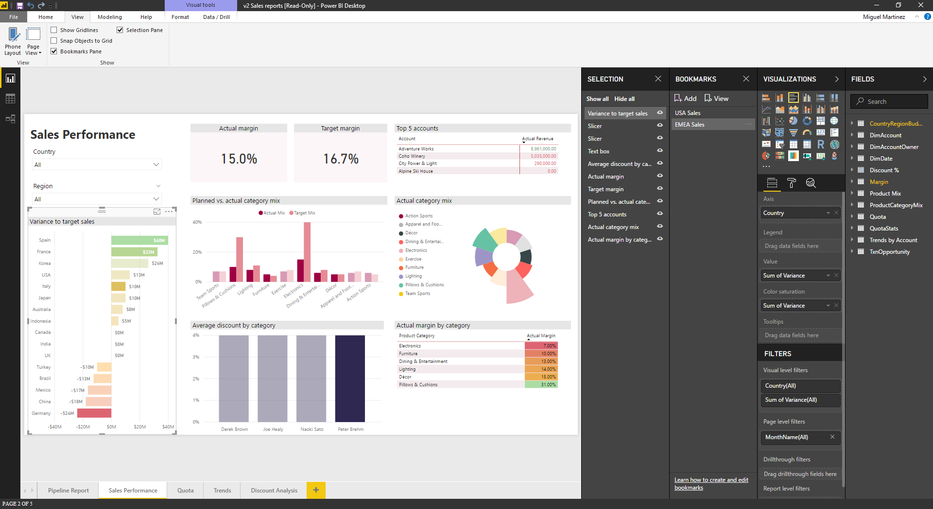
Storytelling and customization with bookmarks
Keep track of states in your exploration
Tell a story with your data guiding your data consumers
Create a custom navigation within a report
Dynamically switch between visuals to tell your story

Slide 19
Built-in intelligence to empower everyone
Quick measures for advanced calculations
Out-of-the-box forecasting and through custom visuals
Grouping, binning, and clustering
Built in integration with R

Slide 20
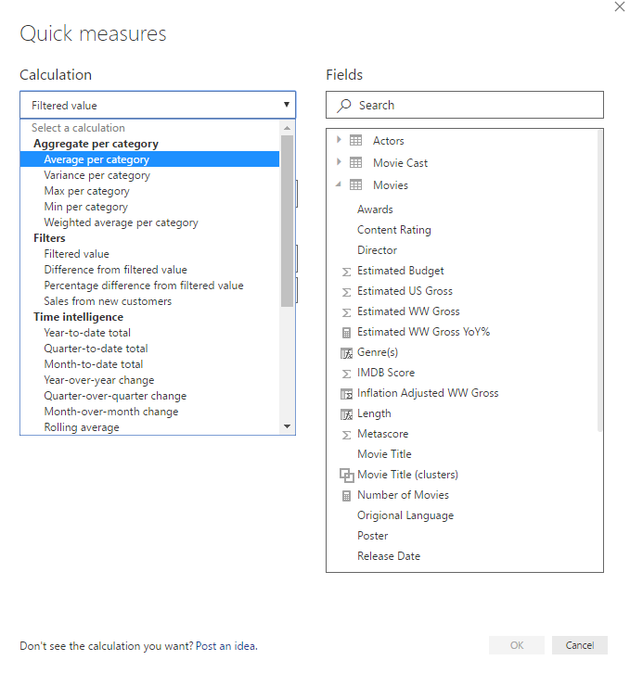
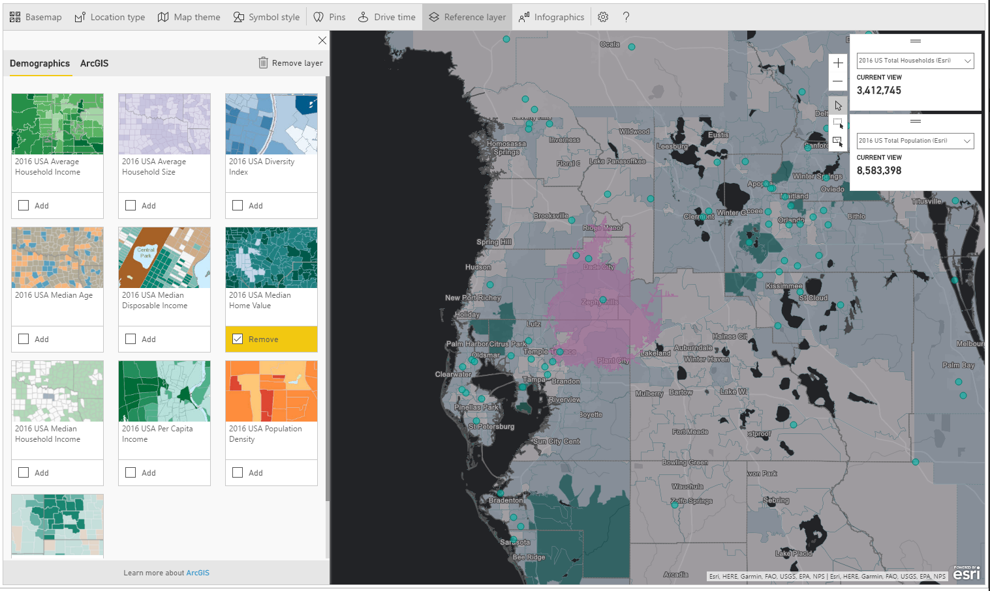
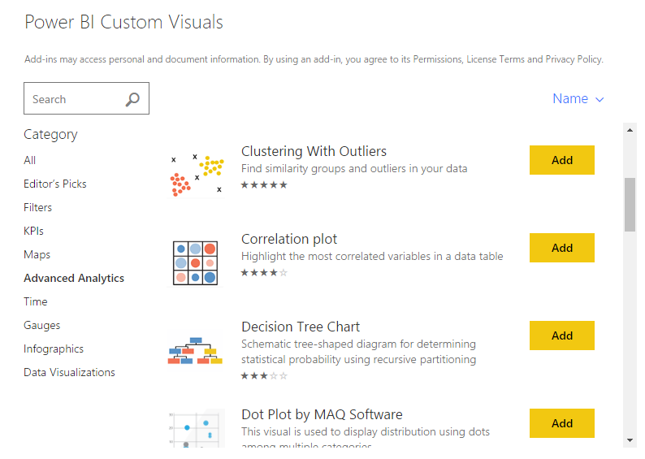
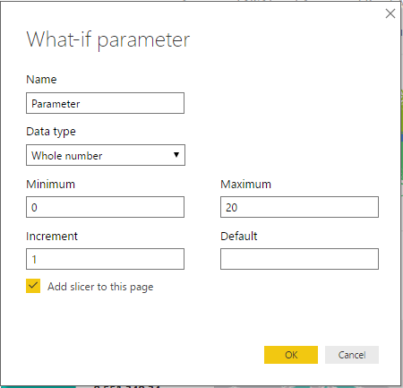
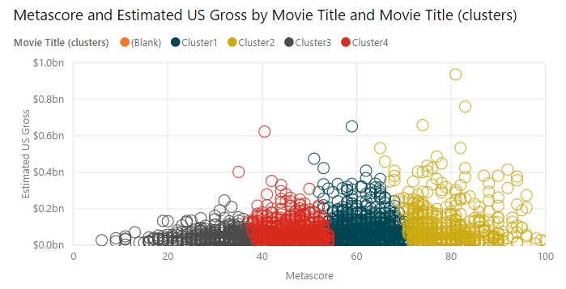
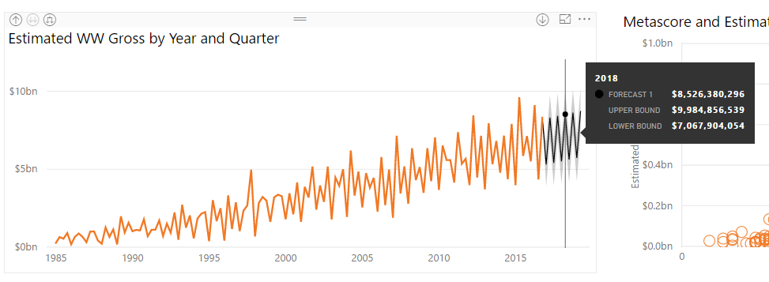
Streamlined for accessible advanced analytics
Keep track of states in your exploration
Tell a story with your data guiding your data consumers
Create a custom navigation within a report
What-if analysis

Slide 21
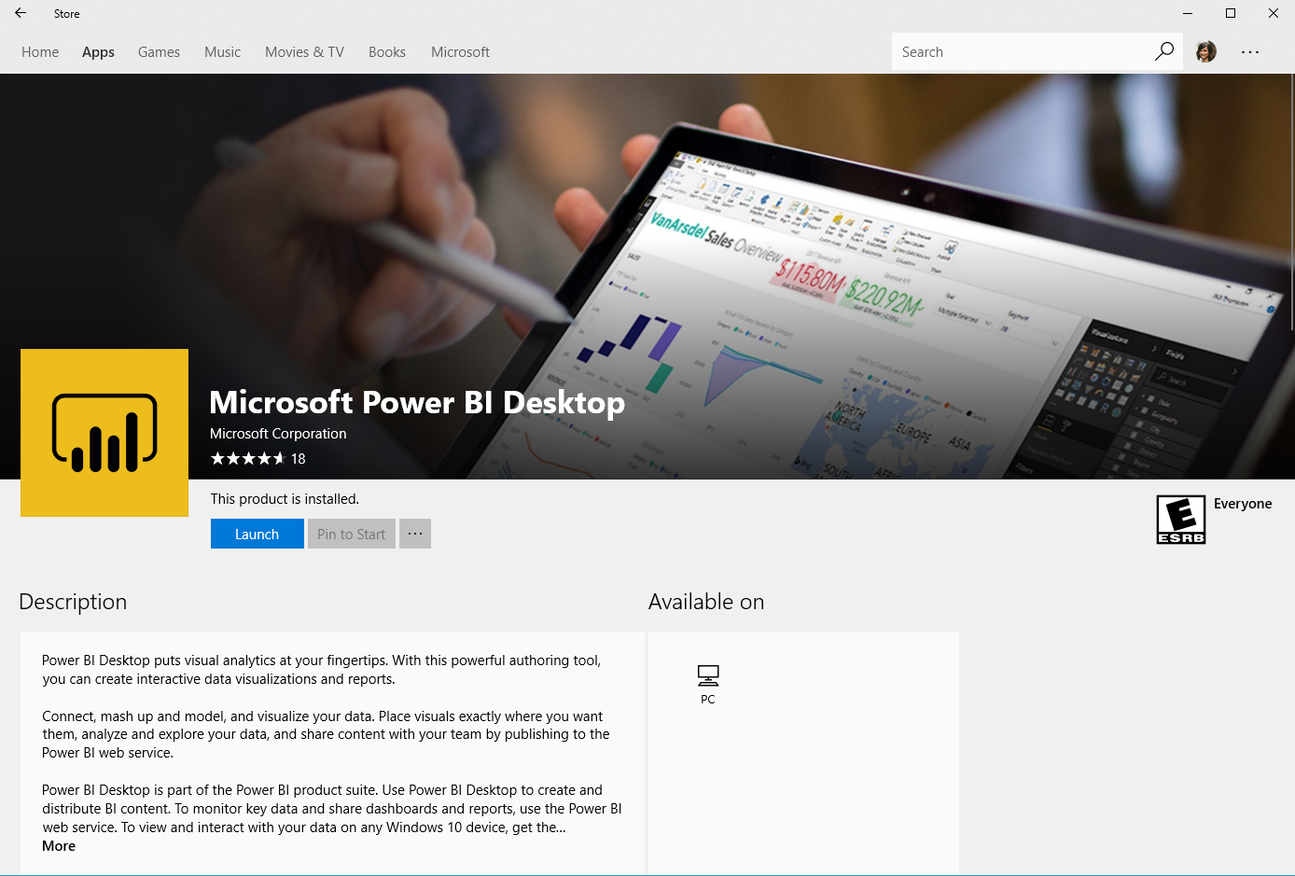
Power BI Desktop in the Windows Store
Empowering everyone in the organization to explore their data
Monthly updates applied automatically
Support for non-admin installation
Administration tools powered by Windows

Slide 22
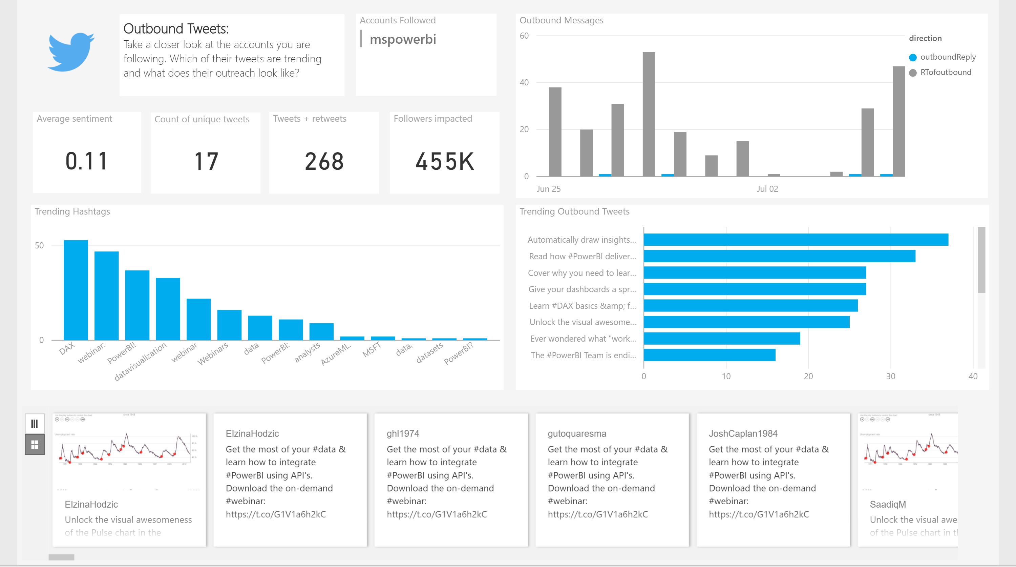
Solution Templates
Address common BI needs with solution templates that incorporate technical and business best practices
Set up a template in minutes, then focus on making it right for you
Easily find a partner who can customize Power BI to meet your unique needs

